Slide 1
A tennis Journey
presented
by
Alejandro
Figueroa

Slide 2
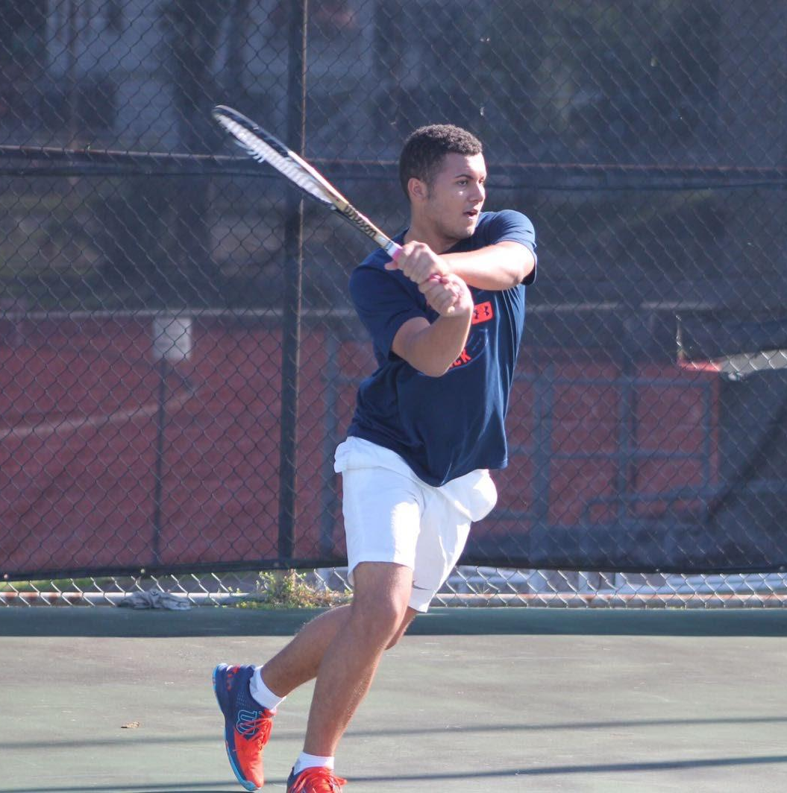
Project Motivation
My tennis journey began 11 years ago…
Played junior league and received a scholarship in college.
Granted me with great friendships, memories and family bonding.
As a tennis fanatic, I have seen the evolution of the game, but not with data.

Slide 3
1
Acquired historical tennis match data from Kaggle: Huge Tennis Database .
4
Conducted EDA on numerical values, including measures of dispersion and histograms.
2
Merged match data from 1968 to 2024 into a single dataset.
5
Formulated and tested hypotheses
(ANOVA, Kruskal-Wallis).
3
Performed data cleaning and preprocessing:
Dropped unnecessary columns.
Changed data type for date column.
Created bins for decades.
Removed columns lacking statistical data.
6
Project Timeline
Compiled findings into a Power BI report.

Slide 4


Hypothesis Test Observations
64.74 %
Lower ranked players beat higher ranked players in professional matches
Over time, it is increasingly common for older players to win matches in professional tennis.
Average match duration has increased from 98 minutes to 117.

Slide 5
Power BI Report

Slide 6


Slide 7


Challenges
48%
Limited Dataset
challenges with ANOVA due to non-normal data distribution.

Slide 8
LAST REMARKS
Feelings about the project
Returning to Power BI
Observing tennis history through data
Room for improvement

Slide 9
GAME, SET
& Match!

